Slide 1
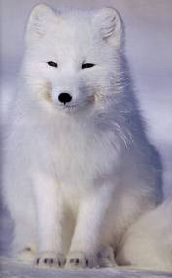
“Adventures Around the World”
Tundra Biome

Slide 2
With Travel Agents..

Slide 3
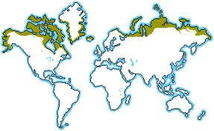
WHERE IS THIS BIOME LOCATED!

Slide 4
“Weather you are wearing a jacket or not it’ll be cold..but its worth it”

Slide 5
“Whether you are wearing a jacket or not it will be cold..but its worth it”
Average: 10 to 20 Degrees F̊ (-12 to -6 degrees C̊)

Slide 6
“Dig up the dirt!”
THE TYPE OF DIRT FOUND IN A TUNdra is called permafrost

Slide 7
Plants In This Biome
Arctic Moss
Arctic Willow
Bearberry
Caribou Moss
Diamond-leaf Willow
Labrador Tea
Pasque Flower
Tufted Saxifrage

Slide 8
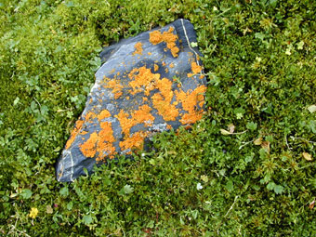
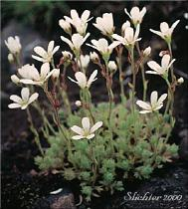
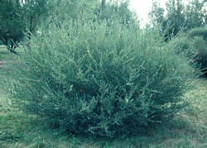
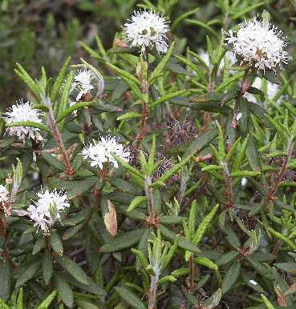
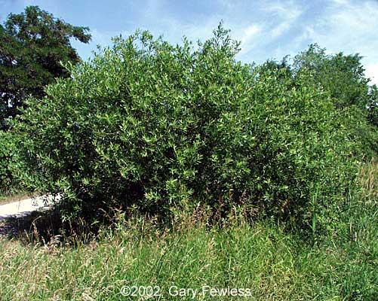
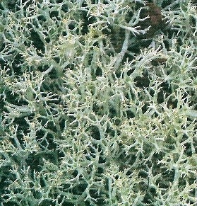
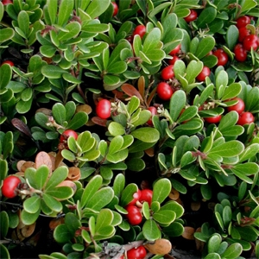
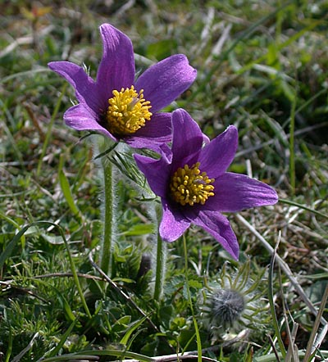
Plants

Slide 9
Animals In this Biome
Arctic Fox
Caribou
Ermine
Grizzly Bear
Harlequin Duck
Musk Ox
Polar Bear
Snowy Owl

Slide 10
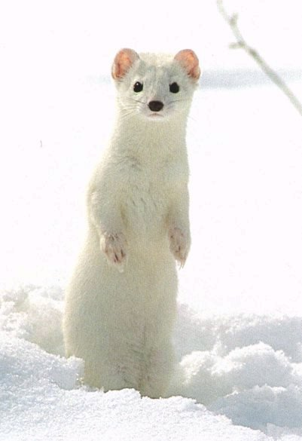
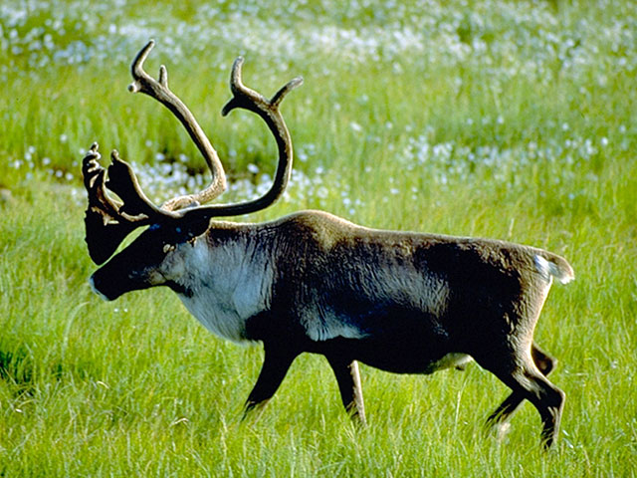
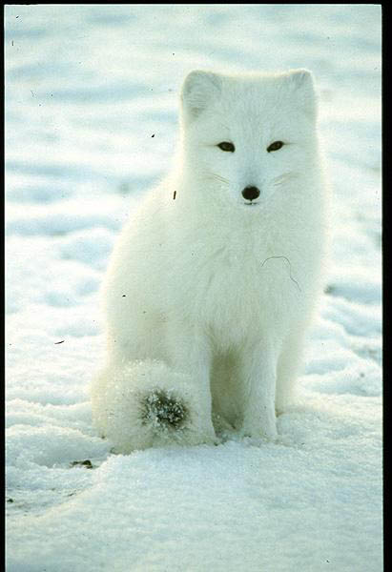
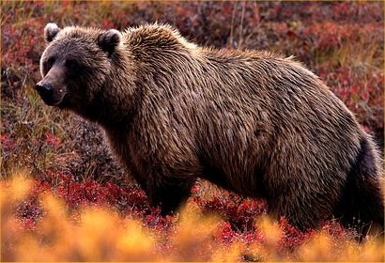
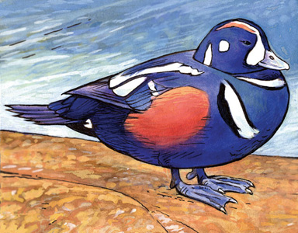
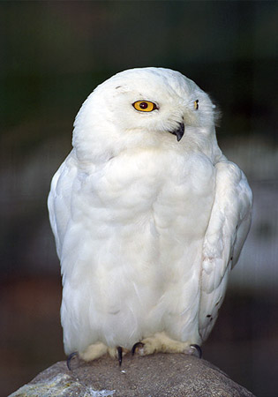
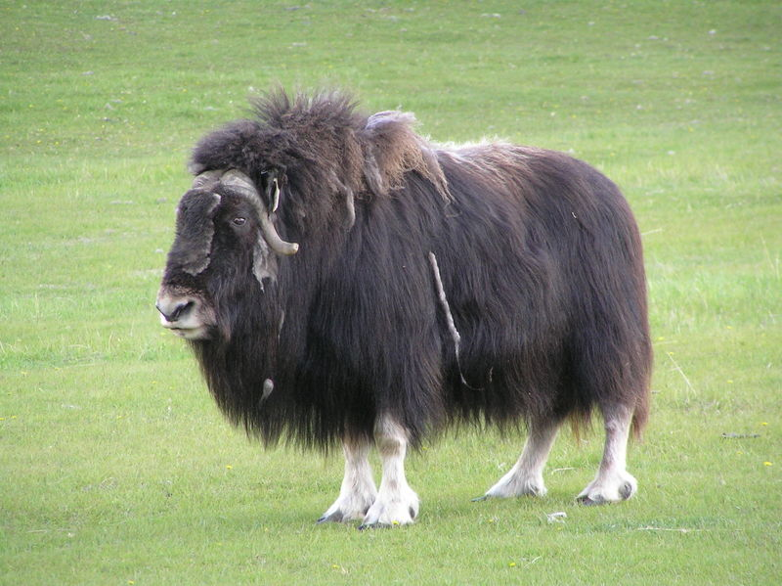
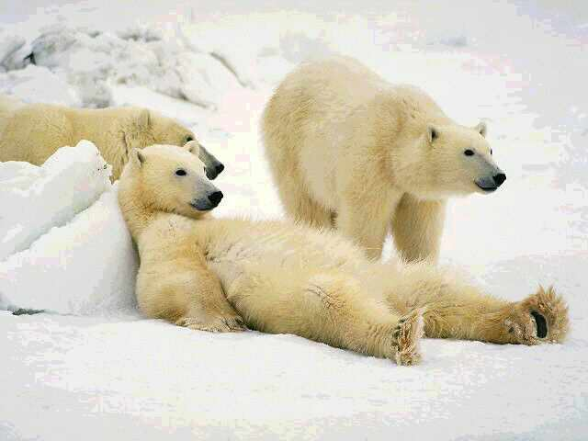
Animals

Slide 11
Threats to the Tundra
Global warming is melting ice in the tundra which is affecting the animals’ homes
Air pollution that causes smog clouds can contaminate lichen
Oil spills can intoxicate the tundra environment

